Slide 1
SOEN 384
Management, Measurement and Quality Control
http://users.encs.concordia.ca/~s384_2/
Instructor: Dr. Olga Ormandjieva
Lecture 6
Quality Modeling and Measurement
Swebok
ISO 25010 (available at the library, 3h loan)

Slide 2
Agenda
definition of quality
Quality Engineering in international standardization
Maintainability Quality Model and Measurement with Logiscope
Key points?
soen384-F15-L6: quality

Slide 3
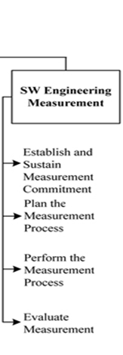
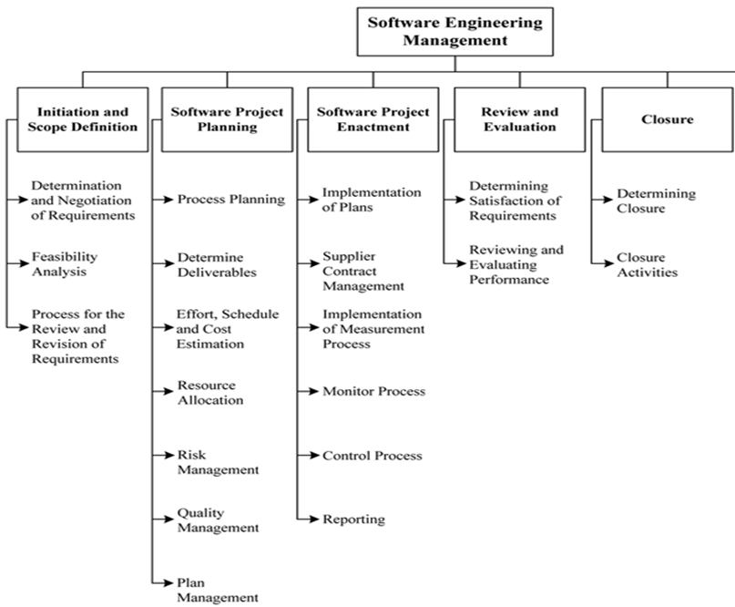
Breakdown of topics for the Software Engineering Management KA
soen384-F15-L6: quality

Slide 4



What is Quality?
Popular views:
  Something “good”
  (but not quantifiable)
  Something luxury and
  classy
Professional views:
  Conformance to
  requirements
  Fitness for use
Porsche Museum, Stuttgart
soen384-F15-L6: quality

Slide 5
Definition of Quality
ISO 8402 definition of quality:
  The totality of features and characteristics of a
  product or a service that bear on its ability to
  satisfy stated or implied needs
soen384-F15-L6: quality

Slide 6
Quality is a collection of “ilities”:
-reliability - the ability to operate failure free
-modifiability - the ability to have enhancement changes made easily
-understandability - the ability to understand the software readily, in order to change/fix it
-efficiency - the speed and compactness of the software
-usability - the ability to use the software easily
-testability - the ability to discover faults by well-defined test cases
-portability - the ability to move the software easily from one environment to another
- maintainability - it can be easily changed
-reusability –i ts parts can be used in other projects, so reprogramming is not needed
soen384-F15-L6: quality

Slide 7
Classification of quality
By observability:
  Internal quality
  External quality
By process:
  Requirements and Specification quality
  Design quality
  Implementation quality
  Test quality
  Maintenance quality
Process quality vs. end-product quality
soen384-F15-L6: quality

Slide 8
What is Software Quality Engineering
  The application of a continuous, systematic, disciplined, quantifiable approach to the development and maintenance of quality throughout the whole life cycle of software products and systems; that is, the application of quality engineering to software
©Witold Suryn 2003-2007
<number> of 60
soen384-F15-L6: quality

Slide 9


Software Quality Engineering Stakeholders
Quality Engineer
Project Manager
Budget Controller
Chief Developer/Tester
SQA Specialist
<number> of 60
soen384-F15-L6: quality

Slide 10
SWEBOK Ch.8 on Quality
“Quality is defined in terms of pertinent attributes of the specific project and any associated product(s), perhaps in both quantitative and qualitative terms. “
  quality characteristics will have been determined in the specification of detailed software requirements
  Thresholds for adherence to quality are set for each indicator
Procedures relating to ongoing SQA throughout the process and for product (deliverable) verification and validation are also specified at this stage
  technical reviews and inspections
soen384-F15-L6: quality

Slide 11
Agenda
definition of quality
Quality Engineering in international standardization
Maintainability Quality Model and Measurement with Logiscope
Key points?
soen384-F15-L6: quality

Slide 12
How to Model Quality?
Choose FACTORS: a set of quality attributes important for a given product from a managerial (external) point of view
decide on their decomposition into quantifiable CRITERIA from the developers (internal) point of view
agree on specific MEASURES for the criteria and specific relationships between them
soen384-F15-L6: quality

Slide 13
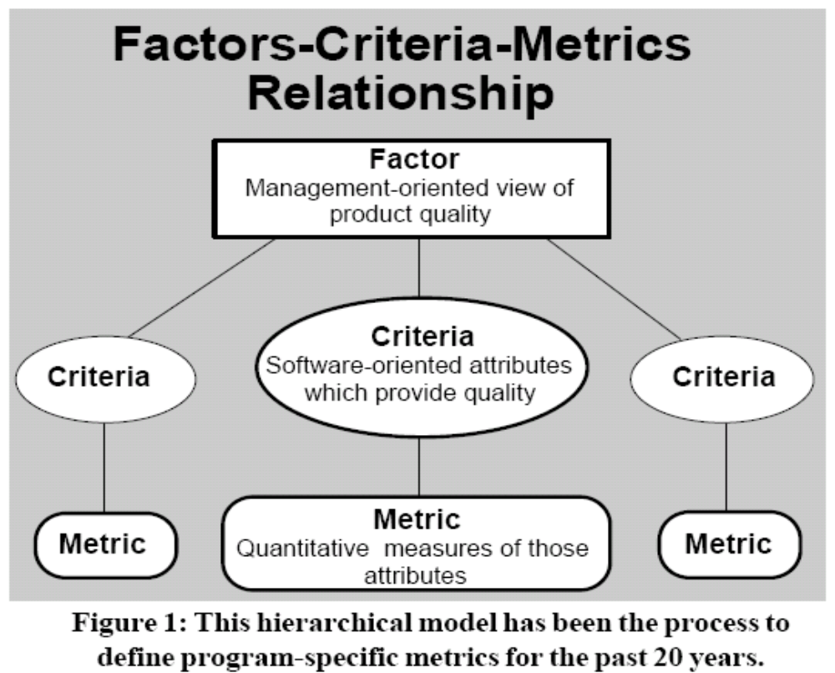
IEEE Std.1061-1998:
Factor – Criteria –Metrics Software Quality Framework
(Criteria)
soen384-F15-L6: quality
Notes:
This hierarchical model has been the process to
define program-specific metrics for the past 30 years.
The “factors” at the highest level of the hierarchical model in
Figure 1 define the overall program issues or objectives which will
be addressed by the selected software metrics.
The “criteria” at the next level of the
Factors-Criteria-Metrics model describe
the software product or process characteristics
which are directly linked to the
program issues and objectives. These
characteristics are defined in softwarerelated
terms and represent the critical
software attributes which must be
achieved in the program. The definitions
of software characteristics at this level are
still rather general and are not defined as
specific quantitative values.
The lowest level of the Factors-Criteria-
Metrics model defines the specific
quantitative units to measure the selected
software criteria. These units are directly
linked to the design and physical structure
of the software.

Slide 14
Software Quality Framework
From top to bottom the framework facilitates
  Establishment of quality requirements, in terms of quality factors, by managers early in a system life cycle;
  Communication of the established quality factors, in terms of quality subfactors (Criteria), to the technical personnel;
  Identification of metrics that are related to the established quality factors and quality subfactors (Criteria).
From bottom to top the framework enables the managerial and technical personnel to obtain feedback by
  Evaluating the software products and processes at the metrics level;
  Analyzing the metric values to estimate and assess the quality factors.
soen384-F15-L6: quality
Notes:
The first level of the software quality metrics framework hierarchy begins with the establishment of quality
requirements by the assignment of various quality attributes, which are used to describe the quality of the
entity system X. All attributes deÞning the quality requirements are agreed upon by the project team, and
then the deÞnitions are established. Quality factors that represent management and user-oriented views are
then assigned to the attributes. If necessary, quality subfactors are then assigned to each quality factor. Asso-
ciated with each quality factor is a direct metric that serves as a quantitative representation of a quality
factor. For example, a direct metric for the factor reliability could be mean time to failure (MTTF). Identify
one or more direct metrics and target values to associate with each factor, such as an execution time of
1 hour, that is set by project management. Otherwise, there is no way to determine whether the factor has
been achieved.
At the second level of the hierarchy are the quality subfactors that represent software-oriented attributes that
indicate quality. These can be obtained by decomposing each quality factor into measurable software
attributes. Quality subfactors are independent attributes of software, and therefore may correspond to more
than one quality factor. The quality subfactors are concrete attributes of software that are more meaningful
than quality factors to technical personnel, such as analysts, designers, programmers, testers, and maintain-
ers. The decomposition of quality factors into quality subfactors facilitates objective communication
between the manager and the technical personnel regarding the quality objectives.
At the third level of the hierarchy the quality subfactors are decomposed into metrics used to measure system
products and processes during the development life cycle. Direct metric values, or quality factor values, are
typically unavailable or expensive to collect early in the software life cycle.

Slide 15
OO Design and Code Quality?
OO Quality
GOAL
Complexity
Factor
Maintainability
Factor
…
Criteria
Criteria
Criteria
Criteria
Coupling
Cohesion
Testability
Inheritance
Metrics
Metrics
Metrics
Metrics
DIT, NOC
CBO
LCOM
WMC
soen384-F15-L6: quality

Slide 16
Scope of application of the quality models (ISO 25010)
support for setting organizational quality goals in the management process.
Support for specification and evaluation of software and software-intensive computer systems from different perspectives (acquisition, requirements, development, use, evaluation, support, maintenance, quality assurance and control, and audit)
  The models can be used by those responsible for specifying and evaluating software product quality.
soen384-F15-L6: quality

Slide 17

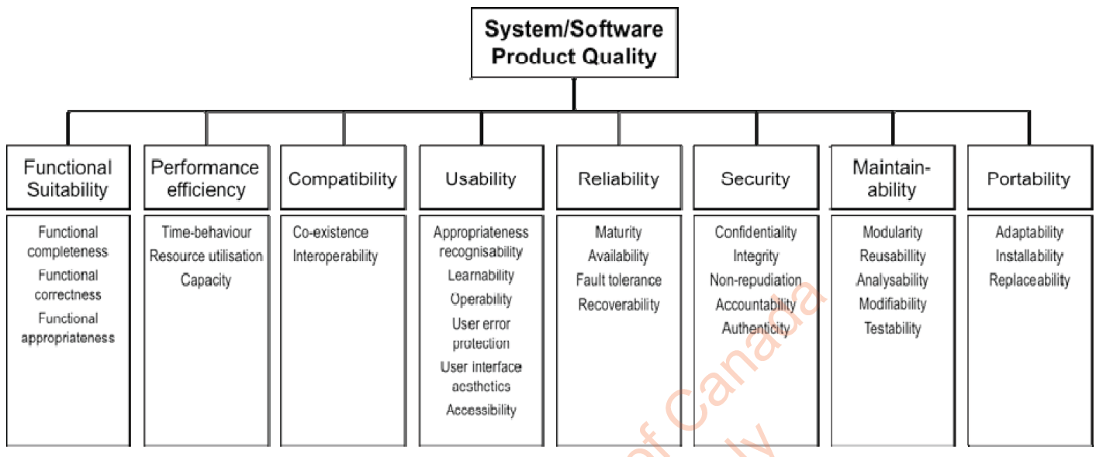

ISO 25010
soen384-F15-L6: quality

Slide 18
TODO
Learn the definitions of ISO 25010 factors (exam material)
soen384-F15-L6: quality

Slide 19
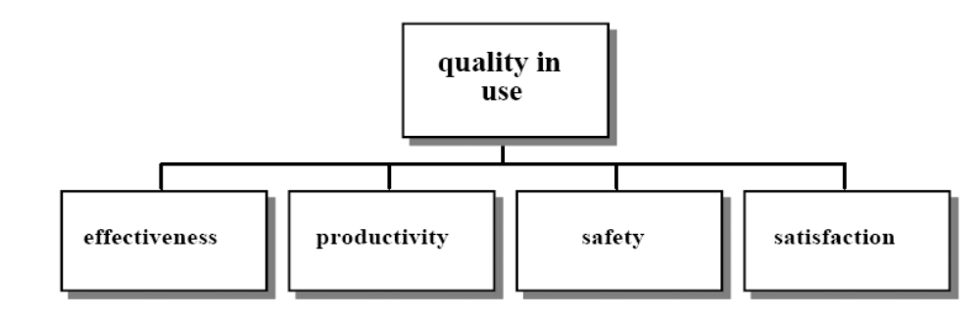
ISO 9126 – Part 4
Quality in Use
soen384-F15-L6: quality
Notes:
Effectiveness metrics assess whether the tasks performed by users achieve specified goals with accuracy and completeness in a specified context of use.
They do not take account of how the goals were achieved, only the extent to which they were achieved
Productivity metrics
Productivity metrics assess the resources that users consume in relation to the effectiveness achieved in a specified context of use. The most common
resource is time to complete the task, although other relevant resources could include the user’s effort, materials or the financial cost of usage.
Safety metrics
Safety metrics assess the level of risk of harm to people, business, software, property or the environment in a specified context of use. It includes the health
and safety of the both the user and those affected by use, as well as unintended physical or economic consequence
Satisfaction metrics
Satisfaction metrics assess the user’s attitudes towards the use of the product in a specified context of use.
NOTE: Satisfaction is influenced by the user's perception of properties of the software product (such as those measured by external metrics) and by the user's perception of the efficiency, productivity and safety in use.

Slide 20
ISO 9126 – Part 4 definitions
Effectiveness metrics
  Effectiveness metrics assess whether the tasks performed by users achieve specified goals with accuracy and completeness in a specified context of use.
  They do not take account of how the goals were achieved, only the extent to which they were achieved
Productivity metrics
  Productivity metrics assess the resources that users consume in relation to the effectiveness achieved in a specified context of use. The most common resource is time to complete the task, although other relevant resources could include the user’s effort, materials or the financial cost of usage.
Safety metrics
  Safety metrics assess the level of risk of harm to people, business, software, property or the environment in a specified context of use. It includes the health and safety of the both the user and those affected by use, as well as unintended physical or economic consequence
Satisfaction metrics
  Satisfaction metrics assess the user’s attitudes towards the use of the product in a specified context of use.
  NOTE: Satisfaction is influenced by the user's perception of properties of the software product (such as those measured by external metrics) and by the user's perception of the efficiency, productivity and safety in use.
soen384-F15-L6: quality

Slide 21
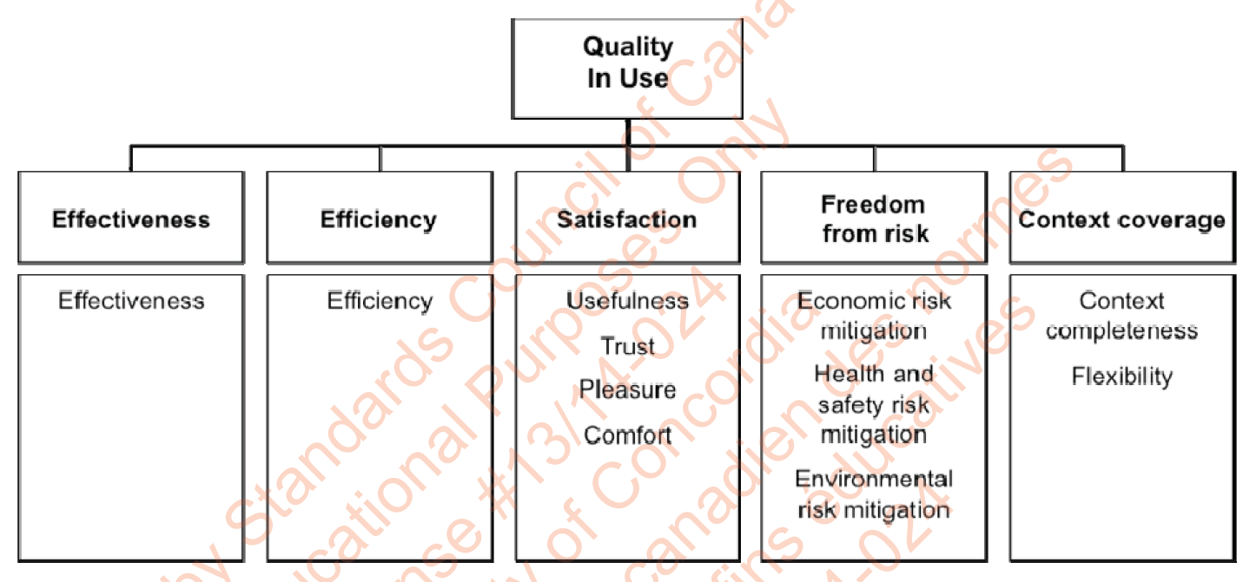

ISO 25022 (not published yet)
soen384-F15-L6: quality

Slide 22
Quality requirements
Feedback to the Next Cycle (Needs)
Requirements
Products
Quality in Use
Requirements
Quality
In Use
Validation
External Quality
Requirement
External
Quality
Validation
Internal Quality
Requirement
Internal
Quality
Validation
soen384-F15-L6: quality
Notes:
Quality in use – non-technical, end-user perspective
External quality – mostly technical, applied to running software/system
Internal quality – technical, applied to software in development
Operational quality- applied to product deployed massively

Slide 23
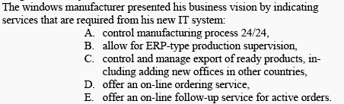
Quality requirements:
How to get them?
(exercise in class)
An experiment:
<number> of 60
soen384-F15-L6: quality

Slide 24


Software Quality Engineering requirements: example 2
Bob: from my quality requirements definition phase I have identified the following, system-level quality attributes: system availability has to be minimum 98%, the mean recovery time should not exceed 1 min/failure and the customer requests that the relative user efficiency be at least 0.9.
Frank: Well, it sounds Ok, but what I am supposed to do with it?
Bob: these attributes have the following impact on your design:
  availability of 98% means that the system must be available 59 minutes out of every operational hour at any time, so your design should strive to exhibit high reliability. One of the options you may take into account is using stable technologies and enhanced application of reuse
  recovery time below 1 min/failure may request applying super efficient recovery algorithms together with extra fast hardware
  user efficiency of 0.9 and above translates into such a functional, user interface and on-line help design that there will be virtually no difference in operation between and average user and an expert.
<number> of 60
soen384-F15-L6: quality

Slide 25
Software Quality Engineering in practice
We rarely engineer into our product everything from ISO models, because:
For a given product not everything is:
  equally important,
  necessary, or
  Feasible,
The budget is always limited (*)
<number> of 60
soen384-F15-L6: quality

Slide 26
Flexibility of Quality Models
You can define your own quality model as a subset of an existing one, based on the stakeholders consensus
The existing quality models provide a worthwhile basis for indirect measures and an excellent checklist for assessing the quality of a system
soen384-F15-L6: quality

Slide 27
Agenda
definition of quality
Quality Engineering in international standardization
Maintainability Quality Model and Measurement with Logiscope
Key points?
soen384-F15-L6: quality

Slide 28
Introducing Logiscope:
Improving confidence … and developer’s productivity
Based on state-of-the-art “best practices”
can process C, C++, Java, Ada, C# and Visual Basic
Available on Windows, UNIX and LINUS platforms
makes possible to evaluate the “maintainability” factor of a group of source files.
MAINTAINABILITY: the capability of the software product to be modified
Modifications may include corrections, improvements or adaptation of the software to changes in environment, and in requirements. and functional specifications
soen384-F15-L6: quality

Slide 29
Decomposition of the Maintainability factor into criteria
Maintainability
ANALYZABILITY: the capability of the software product to be diagnosed for deficiencies or causes of failures in the software, or for the parts to be modified to be identified
CHANGEABILITY: the capability of the software product to enable a specified modification to be implemented
STABILITY: the capability of the software product to avoid unexpected effects from modifications of the software
TESTABILITY: the capability of the software product to enable modified software to be validated
factor
criteria
Analyzability
Changeability
Stability
Testability
metrics
cl_wmc cl_comf in_bases cu_cdused ... … … …
soen384-F15-L6: quality

Slide 30
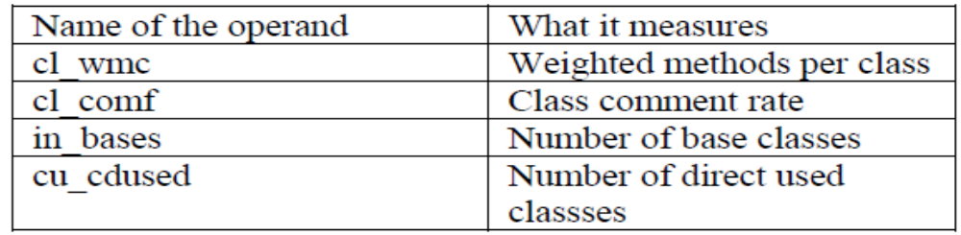
Defining criteria: Analyzability example
ToDo: find the Logiscope definitions of Changeability, Stability, Testability Criteria and the corresponding metrics in the reading material 1, Lecture 6 and/or in the Logiscope documentation
Maintainability
factor
criteria
Analyzability
Changeability
Stability
Testability
metrics
cl_wmc cl_comf in_bases cu_cdused ... … … …
soen384-F15-L6: quality

Slide 31
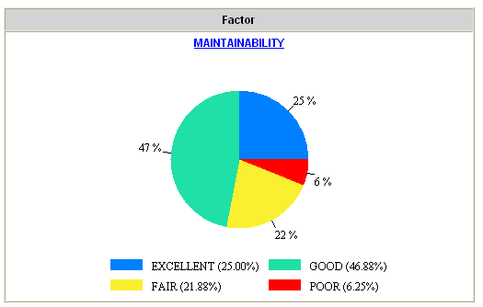
Pie Graph
soen384-F15-L6: quality

Slide 32
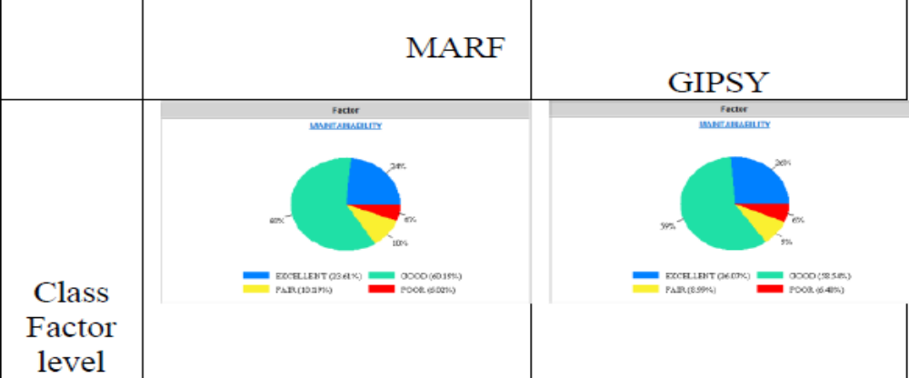
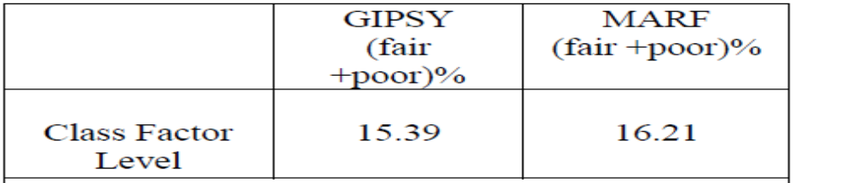
Compare the maintainability of applications at Class Factor level
Maintainability formula for class factor level is:
  MAINTAINABILITY = ANALYZABILITYc + CHANGEABILITYc + STABILITYc + TESTABILITYc [c=class]
Example: compare MARF and GIPSY at Class Factor level
soen384-F15-L6: quality

Slide 33
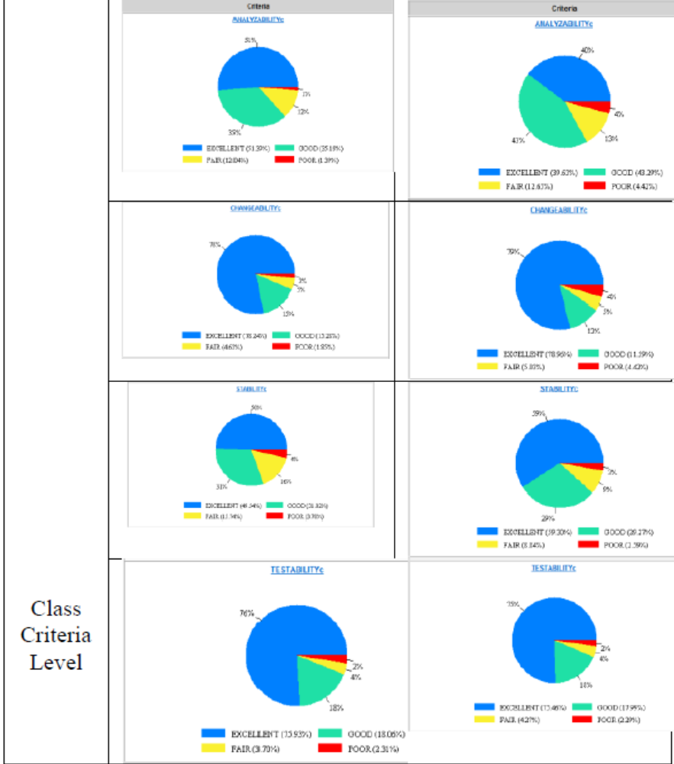
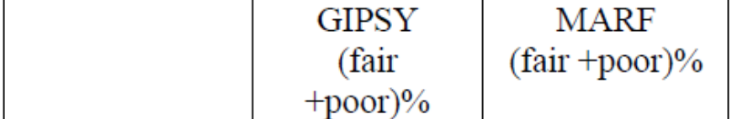
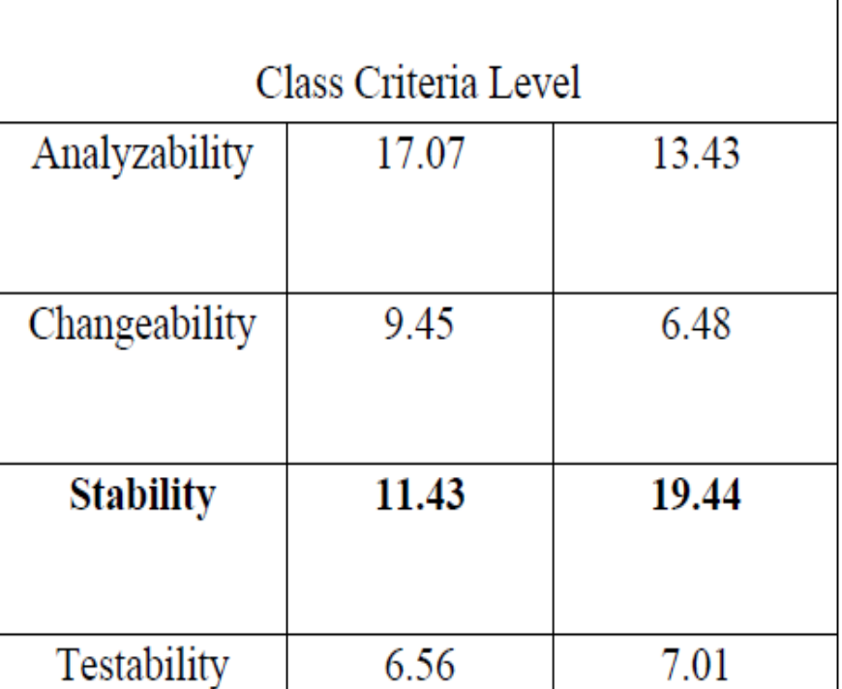
Compare maintainability at Class Criteria Level
soen384-F15-L6: quality

Slide 34
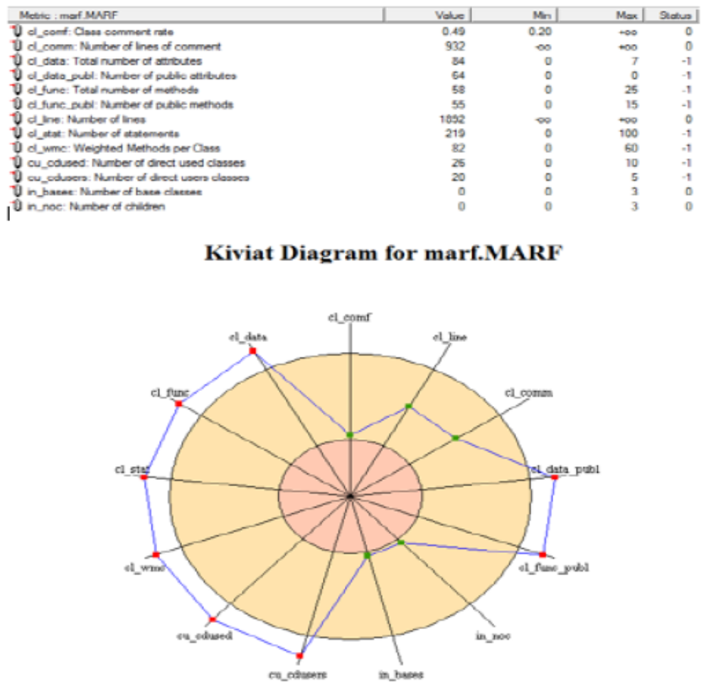
Class Metric level measurement data
soen384-F15-L6: quality

Slide 35
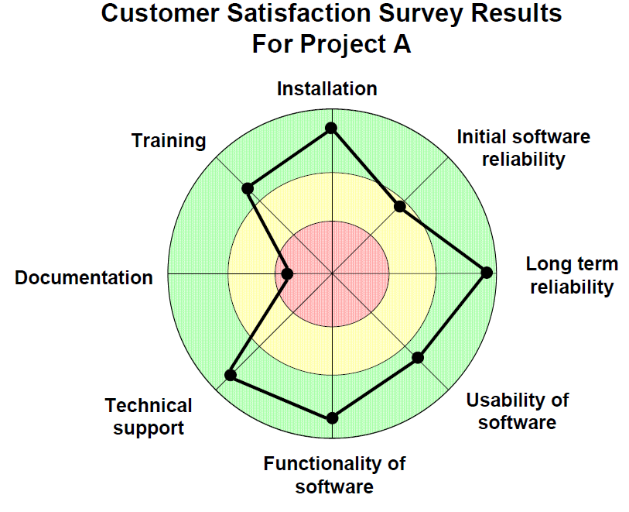
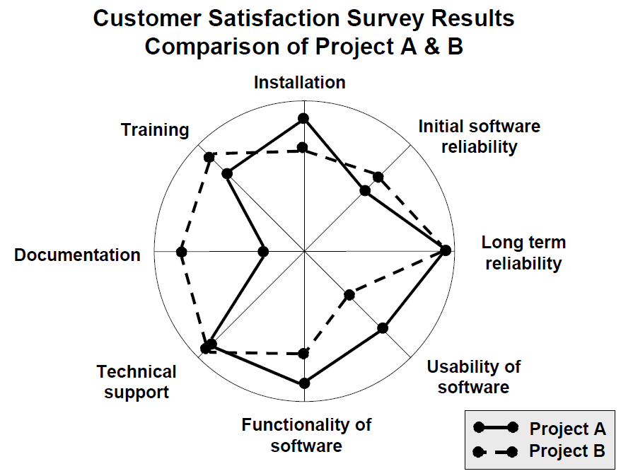
Kiviat Charts
Example source: http://www.westfallteam.com/sites/default/files/papers/Kiviat%20Charts.pdf
  Each “spoke” represents a measure with the measure’s value plotted on that spoke.
  The outer circle symbolizes upper bounds and the inner circle symbolizes lower bounds.
soen384-F15-L6: quality

Slide 36
Logiscope QUALITY CHECKER
Each criteria is associated with a group of metrics and threshold for those metrics (minimum value and maximum value accepted)
For each component (subroutine, class, file), metrics associated with a criteria are computed.
For each criteria, every component comes in a category (Excellent, good, fair, poor) according to the number of metric which does comply with the previously chosen thresholds.
Lastly, each component is associated with a category (excellent, good, fair or poor) according to the maintainability.
All the component rated as “poor are called « critical component » and will be hard to maintain.

Slide 37
Questions?
…
soen384-F15-L6: quality

Slide 38
Next?
Scale types of measurement
soen384-F15-L6: quality

